Slide 1


CS 6831 Designing Secure Cryptography
Tom Ristenpart

Slide 2
Block ciphers
Deterministic encryption
Frequency analysis attacks
Tweakable block ciphers
Tweaking Luby-Rackoff
LRW construction
XE construction

Slide 3

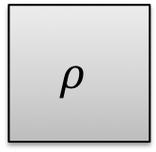
Deterministic encryption
Length-preserving encryption
“wide-block” block ciphers: how to encrypt (say) 4096 byte block
EME, EME2, CMC, XTR, TET, …
Format-preserving encryption (FPE)
Block-cipher on “strange” domain (e.g., all 15-decimal digit strings)
Build using Feistel style constructions, cycle walking
Often used as-is to symmetrically encrypt data
Legacy constraints (old data formats)
Space constraints (no ciphertext expansion)
Examples: Database encryption, Disk encryption
M
M
E_{K}
$$ρ$$
$$≈$$
C
C
PRF security
Survey of FPE and variants: http://web.cs.ucdavis.edu/~rogaway/papers/synopsis.pdf

Slide 4




Sensitive databases
Database
Person | Age | Income
Alice | 22 | 100,000
Bob | 29 | 25,000
Charlie | 31 | 40,000
Client
(e.g., workstation, web server)
Banks and other companies store significant amounts of sensitive data
Databases provide rich queries to quickly fetch relevant data:
Equality search (find all rows with name “Alice”)
Range queries (all rows with 20 <= Age <= 30)
Sorted lists (return records ordered by salary)
Sensitive databases key target for attackers

Slide 5


Proxy-based encrypted databases
Insert
Alice, 22, 100000
Bob, 29, 25000
…
Insert
C1, C2, C3
C1’, C2’, C3’
…
Database
Person | Age | Income
Alice | 22 | 100,000
Bob | 29 | 25,000
Charlie | 31 | 40,000
C1
C2
C3
Clients
Encryption proxy
C1’
C2’
C3’
C1’’
C2’’
C3’’
C1 = E(K₁, Alice)
C2 = E(K₂, 22)
C3 = E(K₃, 100000)
C1’ = E(K₁, Bob)
C2’ = E(K₂, 29)
C3’ = E(K₃, 25000)

Slide 6
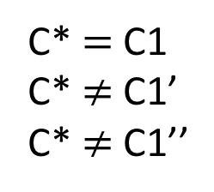
Performing DB operations
Select all rows with
person = Alice
Select all rows with
person = C*
Database
Person | Age | Income
Alice | 22 | 100,000
Bob | 29 | 25,000
Charlie | 31 | 40,000
C1
C2
C3
Clients
Encryption proxy
C1’
C2’
C3’
C1’’
C2’’
C3’’
Proxy recomputes C1 by encrypting search term Alice
C* = E(K₁, Alice)
C* $=$C1
C* $≠$ C1’
C* $≠$ C1’’
Works with existing DB implementations!

Slide 7



Frequency attacks against deterministic encryption
Idea: if attacker knows something about distribution of plaintexts, we can exploit it
[Al-Kindi 9th century BCE]
[NKW 2016]
Estimate using public datasets.
Ex: Facebook names dataset
Plaintext distribution
Ciphertext distribution in database
Frequency
alice
tim
bob
john
jane
C1
C2
C3
C4
C5
For “good” ciphers, this is all information adversary gets from database
Frequency analysis best-possible attack

Slide 8

Unknown message attacks (ciphertext only attacks)
Adversary must recover messages associated to ciphertexts
p_{m} is message distribution
Assume sample time is T(p_{m}) and has compact representation
We will assume adversaries know it
Adversaries do not see coins used to draw messages
Adversary outputs a function

Slide 9
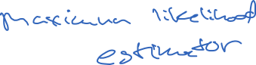
Unknown message attacks (ciphertext only attacks)
Adversary must recover messages associated to ciphertexts

Slide 10
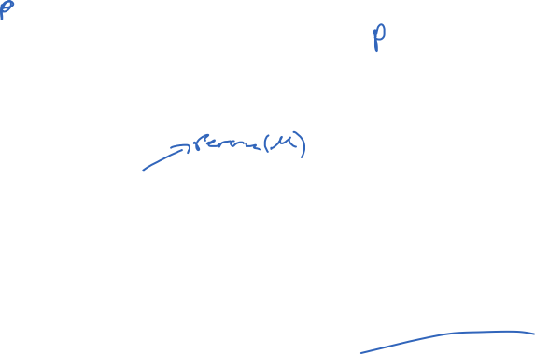

Slide 11

A* is maximum-likelihood estimator
But: can show upper bound using this term on Pr[G1^{A}] ?

Slide 13


Understanding frequency analysis efficacy
Analytical approach only gets us so far… how do we analyze effectiveness of A*?
We can look at it via simulated case studies
Get representative datasets
Released healthcare data, breach datasets, etc.
Use to estimate p_{m}
Empirical estimator
Machine learning approaches
Simulate attacks using
In practice attacker can’t expect perfect knowledge of
Give independent dataset to A* to make its own estimate

Slide 14
Understanding frequency analysis efficacy
Analytical approach only gets us so far… how do we analyze effectiveness of A*?
Non-uniform, small-domain values easy to recover
[Bindschaedler et al. 2018] simulated attacks: Recovers 100% of DET-encrypted values in hospital datasets
Most columns binary or small number of possibilities
More uniform, larger-domain values can be harder to recover
[Naveed et al. 2016] simulated attacks:
Recovers 10% of DET-encrypted age values in hospital datasets
Data closer to uniform
Good plaintext distribution estimates harder to get

Slide 15
Deterministic encryption
Chosen-message attacks even more damaging
[Cash, Grubbs, Perry, R. 15], [Zhang, Katz, Papamanthou 16]
Randomized encryption can prevent such attacks (stay tuned)
First: provide more “isolation” while still deterministic

Slide 16
Tweakable ciphers
One idea is to ”isolate” rows
Ex: distinct key per row
Derive using secret key and row identifier
Breaks search functionality, but prevents per-column frequency analysis
Realizes a tweakable block cipher [Liskov, Rivest, Wagner 2005]
Database
Person | Age | Income
Alice | 22 | 100,000
Bob | 29 | 25,000
Charlie | 31 | 40,000
C1
C2
C3
C1’
C2’
C3’
C1’’
C2’’
C3’’

Slide 17
Tweakable ciphers
Set of all functions
such that for fixed tweak, function is a permutation
Extension of PRP/PRF switching lemma applies here to TPRP

Slide 18
Tweakable ciphers
L0 R0
F_{K}
<1> || T
Can tweak Luby-Rackoff pretty easily, if F is PRF with variable input length
(analysis via extension of previous proof)
+
L1 R1
Question: how to do fast TPRP from PRP?
F_{K}
<2> || T
+
L2 R2
F_{K}
<3> || T
+
L3 R3

Slide 19
Tweakable ciphers
Can tweak Luby-Rackoff pretty easily, if F is PRF with variable input length
Question: how to do fast TPRP from PRP?
Assume tweak, message spaces {0,1}^{n}
M
M 1
T
T 1

Slide 20
Tweakable ciphers
Can tweak Luby-Rackoff pretty easily, if F is PRF with variable input length
Question: how to do fast TPRP from PRP?
Assume tweak, message spaces {0,1}^{n}
M
M
M 1
T
T 1
T

Slide 21
Tweakable ciphers
Can tweak Luby-Rackoff pretty easily, if F is PRF with variable input length
Question: how to do fast TPRP from PRP?
Assume tweak, message spaces {0,1}^{n}
M
Why does this work?
Intuition: For all M,T and M’,T’
T
is small

Slide 22
Analysis
M
M
T
Actually this construction
is equivalent to CBC-MAC!
T
CBC-MAC[E](K,M||T)
Special case of [Bellare, Killian, Rogaway 99] gives that for any A there is B s.t.
Here B must make 2q queries when A makes q queries

Slide 23
Analysis
Extension of PRP/PRF
switching to tweaks
CBC-MAC[E] and are
the same
Bellare et al. result on
CBC-MAC. (2q queries)
Should be able to optimize constants with direct reduction to PRP/PRF security of E

Slide 24
Even faster tweakable blockciphers?
Question: how to do fast TPRP from PRP?
Assume tweak, message spaces {0,1}^{n}
M
Requires two E calls per message
Can we do better?
T

Slide 25
Even faster tweakable blockciphers?
Question: how to do fast TPRP from PRP?
Assume message spaces {0,1}^{n}
i
M
Ideal to have something like this, where
i can be an integer
T
But this is insecure!

Slide 26
Essentials on GF(2^{n})
GF(2^{n}) is Finite (Galios) Field over n-bit strings
Represent point a equivalently as:
Polynomial
Integer
Bit string

Slide 27
Essentials on GF(2^{n})
GF(2^{n}) is Finite (Galios) Field over n-bit strings
Addition = bitwise xor of points (as bit strings)
Multiplication:
fix primitive poly. For n = 128 use
Multiple points ac by treating as polynomials, multiplying formal polys, and take remainder mod fixed prim poly

Slide 28
Essentials on GF(2^{n})
Multiplication by 2 is fast!
Divide by primitive polynomial and take remainder
If a_{n-1} = 1 then:
left-shift a by 1 and add prim poly
If a_{n-1} = 0 then:
left-shift a by 1
One shift and one conditional xor!

Slide 29
Fast TPRPs: XE construction
[Rogaway 2004]
Given a good PRP (e.g., AES) how do we build a tweakable PRP?
Assume
2^{i}
M
Multiplication in GF(2^{n}) using primitive
polynomial. This means that
2Y, 4Y, 8Y, …
are all distinct! (Think Y = E_{K}(T) )
Proof by showing low ability to force collisons in input to second E (XOR-universal hash proof)
T
But is this fast?
Yes in an amortized sense:
Computing 2Y given Y is 1 shift and 1 conditional xor!

Slide 30
Next up: randomized encryption

